Slide 1
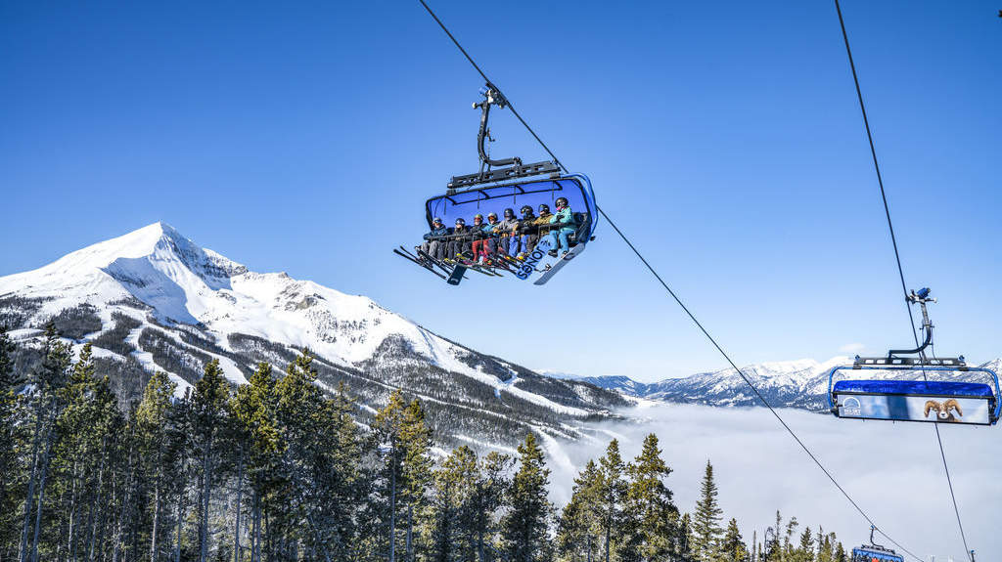
CELEBRATING
YEARS
JOIN US FOR THE 50TH ANNUAL
VOS CONFERENCE
BIG SKY, MONTANA
MARCH 11-18, 2023
COME FOR THE LEARNING,
STAY FOR THE FAMILY

